Slide 1
Opportunistic Infection Update
Richard A. Murphy, MD, MPH
Geisel School of Medicine at Dartmouth
White River Junction VA Medical Center
Disclosures: None

Slide 2
Goals
Describe epidemiology of advanced HIV and why it remains a persistent concern
Share updates on common HIV-associated opportunistic infections
Discuss aspects of ART in the setting of advanced HIV
Notes:
I became interested in advanced HIV as a resident and then as a fellow in SA.
In Durban, under masters like HS, Yunus Moosa and through the HOPE Conf with Raj Gandhi, my interest grew (especially around making systems work better for this patient group)
Nowadays most of the important research on OIs and advanced HIV comes from RLS, particularly southern Africa
In my view, even though OIs and adv HIV are less common than 10 years ago, continuing to improve our approach to these entities remains really impt to reducing HIV-related deaths
It’s notable there continue to be a significant number of deaths associated with advanced HIV globally but there is less new research than in the past.
Geographically most of new OI research that is occurring comes from RLS, particularly from Southern Africa.
Reflects increasing research capacity there but also an significant patient pop’l adv HIV
The exception is CM, tuberculosis where there have been some important breakthroughs
I’ll stay away from TB in anticipation of Rocio Hurtado’s talk in a couple of weeks.

Slide 3
Advanced HIV priority interventions & leading causes of mortality among adults with AHD
WHO recommend. for persons with advanced HIV (2017) incl:
If sxs, TB testing with Xpert / urine LAM (→ TB therapy or IPT)
If CD4 <100, CrAg testing (→evaluation and treatment)
Rapid ART (re)initiation (unless current CM or TB-M)
Cotrimoxazole prophylaxis
Anyone keeping track ?
WHO Advanced HIV Disease 2017
Notes:
Where is the WHO on this topic? About 5 yrs ago, as part of the recognition that patients living with HIV have varied clinical needs (ie the rationale for care differentiation) and after the publication of the REALITY trial the WHO redefined AIDS as advanced HIV and made some endorsements including:
They did not endorse expanded prophylaxis package that was shown in the REALITY clinical trial to reduce mortality that included 12 weeks of fluconazole, 5 days of azithromycin, and a single dose of albendazole.
Proportion of patients in this category receiving evaluation with XPERT and LAM?
Proportion receiving CPT?
Proportion of those found to be serum CrAg (+) or LAM (+) receiving appropriate diagnostics& treatment

Slide 4
SAHCS Adult AHD Guidelines - 2022
Approach to and management of common clinical scenarios:
Renal impairment in adv. HIV
Diarrhea, chronic and acute
Brain space occupying lesions
Acute and chronic meningitis
Respiratory presentation
Altered mental state
Patient deteriorating despite treatment for an OI
Use of steroids in AHD
Stead et al. SAHCS 2022 Adult AHD Guidelines
Notes:
To help managed patients with adv HIV on a practical level, the HIV Clin. Society gave us a gift in 2022: clinical guidelines providing a real cerebral but common sense approach to typical scenarios in pts with adv HIV
Some of the advice is specific to SA but most of it can be generalized
They don’t avoid any of the really scary scenarios – such as patient deteriorating despite treatment for OI -- and to guide you they include excellent flowcharts. If you haven’t downloaded it, do it.

Slide 5
Chronic diarrhea
Notes:
Chronic diarrhea is not a topic of much active investigation but there are some principles established some years ago that remain important today as well as a few interesting recent reports

Slide 6
Case
27 yo M with HIV originally from Cameroon
2 yrs ago diagnosed w/ HIV when p/w diarrhea during migration
Initial CD4 not known, started TEE
1 yr ago diarrhea persisted despite CD4 732 and VL <50
He had records from recent admission in Spain 2m prior showing:
(+) peripheral eosinophilia (2500/ul), low Na, K, Mg
Stool culture & direct visualization (-), Cryptosporidium & Giardia Ags (-) no blood or mucus in stool
Rec’d praziquantel + albendazole empirically without resolution
Presents with watery, large volume diarrhea and cachexia.
Exam: Afebrile, abdomen scaphoid but NT
Rial-Crestelo D. AIDS 2022
Notes:
All chronic diarrhea in this setting require stool MC&S plus a modified auramine stain (some labs do this routinely but safe to request the modified auramine stain specifically), up to 3 samples if negative

Slide 7
What is the most likely pathogen?
Clostridium difficile
Cryptosporidium infection
Gastrointestinal tuberculosis
Cystoisospora belli (formerly, Isospora belli)
Notes:
-Summarize: Essential we have a patient who initially had AHD with chronic diarrhea that has been ongoing despite immune restoration and virologic suppression with elev. eosinophils with wt loss suggest this is impt.
-C. diff more commonly causes hospital-onset diarrhea but community onset is possible. However he lacks recent antibiotic exposure and eosinophilia is not a typical feature.
-Cryptosporidiosis is an impt cause of chronic diarrhea with weight loss in adv HIV infection. The stool antigen test is ~90% sens for this pathogen. Also typically cryptosporidiosis will resolve with ART and immune reconstitution.
-TB can take various forms in GI tract incl involvement of the distal ileum, cecum or colon with diarrhea. But he lacked fever, and no e/o TB elsewhere was given. Further untreated TB is unlikely to persist for years in HIV.
-Leaves us with cystoisospora

Slide 8
Cystoisospora belli, formerly Isospora belli
Unicellular protozoan parasite; invades sm. intestinal enterocytes
Closely related to Cryptosporidium
Weeks to months of profuse, watery, noninflammatory diarrhea
In South Africa recommended test: stool modified auramine stain, as it (like Cryptosporidium) has acid-fast properties
Unlike cryptosporidiosis, no stool antigen test
Multiple samples help – oocysts intermittently shed. May be hard to find even in those severely infected.
If stool negative, duodenal aspirate or intestine biopsy may be helpful
Unlike other causes of chronic diarrhea in AHD, it characteristically causes peripheral eosinophilia, an impt clue
Notes:
Don’t you love it when they rename pathogens you already struggle to remember? Cutibacterium
In SA, this is what is recommended. See if you can find out why preferred over wet mount or fecal smear. Manpower issue?

Slide 9
HIV-related chronic diarrhea in southern Africa
Major causes thought to be cryptosporidiosis and Cystoisospora belli
GI TB (and MAC) can be associated with chronic diarrhea usually with prominent fever. Often evidence of TB elsewhere (✓ XPERT, LAM, U/S, mycobacterial blood culture)
2008 (France): In patients of African origin with AHD and chronic diarrhea
cryptosporidiosis 48%, Cystoisospora belli 30%, microsporidiosis 20%
2018 (Mozambique): Hospitalized with advanced HIV and chronic or acute diarrhea
Cystoisospora belli - 25%, cryptosporidiosis - 8%
In “acute” HIV-assoc. diarrhea, Cystoisospora belli + cryptosporidiosis also common
In this study no search for CMV-related, no comment on GI TB-related diarrhea
2019 (Thailand): In with advanced HIV and acute or chronic diarrhea:
cryptosporidiosis 67%, Strongyloides 6%, microsporidiosis 6%, Cystoisospora belli 2%
Casmo V. et al Heliyon 2018. Sannella A et al Parasites and Vectors 2019 HIV Medicine 2008
Notes:
Background: Chronic diarrhea in AHD generally defined as lasting >2 wks and in South Africa major causes have been though to be Cryptosporidium and Cystoisospora belli
Little recent data on causative pathogens of chronic diarrhea in AHD
Is microsporidiosis common in African settings? It is prob 3rd most impt parasite
Mention that TB can present with TB especially if GI TB.
Blood or mucus; go down a diff pathway
Assefa S, Erko B, Medhin G, Assefa Z, Shimelis T. Intestinal
parasitic infections in relation to HIV/AIDS status, diarrhea
and CD4 T-cell count. BMC Infect Dis 2009; 9:155.
4. Mohanty I, Panda P, Sahu S, Dash M, Narasimham MV, Padhi S,
Parida B. Prevalence of isosporiasis in relation to CD4 cell
counts among HIV-infected patients with diarrhea in Odisha,
India. Adv Biomed Res 2013; 2:61.
5. Nsagha DS, Njunda AL, Assob NJC, Ayima CW, Tanue EA, Kibu
OD, Kwenti TE. Intestinal parasitic infections in relation to
CD4(R) T cell counts and diarrhea in HIV/AIDS patients with
or without antiretroviral therapy in Cameroon. BMC Infect Dis
2016; 16:9.

Slide 10
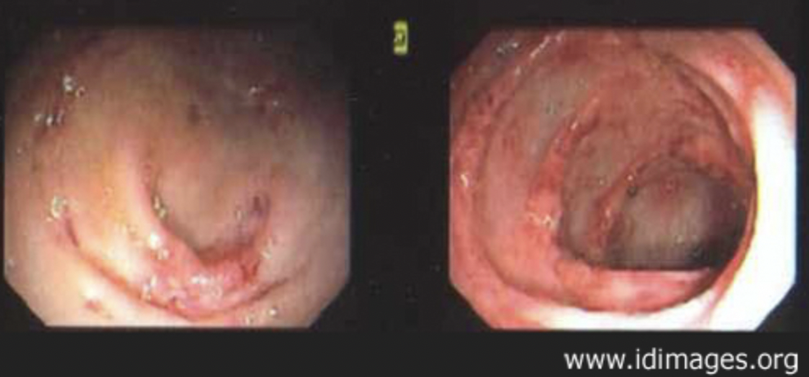
Should CMV colitis be considered in HIV-associated chronic diarrhea in African settings?
CMV colitis causes chronic diarrhea in AHD, typically with fever, abd. pain, weight loss. Blood in stool common; perforation can occur
No data on prevalence in southern Africa
For patients with advanced HIV and chronic diarrhea with unrevealing stool and TB studies, proceed to flex. sig. / colonoscopy
Ulcers seen endoscopically, bx confirms
Ganciclovir IV/valganciclovir PO + rapid ART
Check for CMV elsewhere (i.e. retinas)
ID Images Case #02009
Notes:
Talk to King Edward specialist on approach to chronic diarrhea in AHD if MC&S and auramine negative. At what point is flex sig or colonoscopy done?
Fever not a prominent part of Cryptosporidium or Cystoisospora belli infections

Slide 11
What is the therapy for Cystoisospora belli?
Albendazole
Metronidazole
Cotrimoxazole
Ciprofloxacin
No specific therapy exists
Notes:
Albendazole is recommended for microsporidiosis even though reclassified as fungi; figure that out
Metronidazole is effective against giardia and C diff.
Cotrimoxazole is active against Isospora belli and outperformed ciprofloxacin in an RCT in Haiti
No specific therapy exists – that is true for Cryptosporidiosis in adv HIV

Slide 12
Cystoisospora belli
SA treatment (adult): cotrimoxazole 4 SS (80/400) BID x 10d
[1 DS BID x 7 d also effective: Verdier et. al. Ann Intern Med 2000]
Electrolyte monit., treatment of dehydration & malnutrition, rapid ART
50% relapse → restart therapy but for 30d and then taper
2nd prophyl: cotrimoxazole DS QD/TIW until VL UD + CD4 >200 for 6m
“Isosporiasis in 8 patients with HIV despite antimicrobials and ART”
Median (high) symptomatic CD4: 373/mm³
All had undetectable VL while remaining symptomatic
Diagnosis: 34% of stool samples (+), 63% of duodenal bx (+) for oocytes
Outcome: 50% died, 25% remained symptomatic, 25% recovered.
Boyles et al. SAHCS 2022 Adult AHD Guidelines. Boyles T, et al. PLOS One. 2012
Notes:
Check DHHS OI guidelines for cystoisospora treatment recs

Slide 13
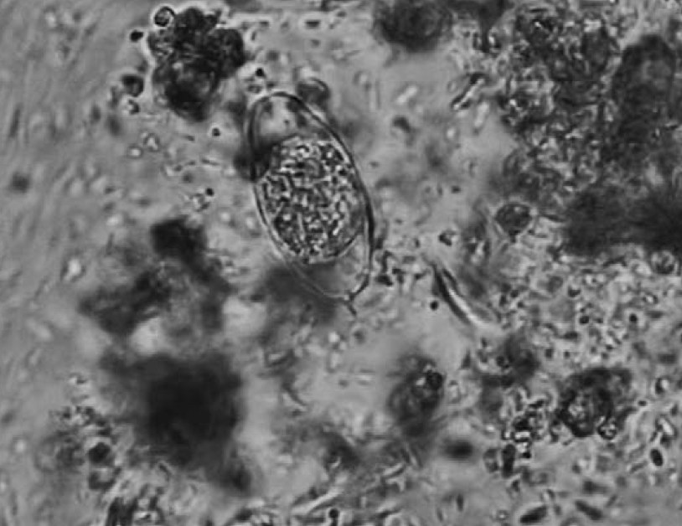
Case
Finally, duodenum samples from a new endoscopy showed structures compatible with Cystoisospora belli
Repeat stool exam finally revealed oocysts →
He received cotrimoxazole and symptoms resolved
Eosinophilia resolved
4 months later, he remained symptom-free and gained 28 kg
Fecal smear: Oval oocyst in center
Rio-Crestelo et al. AIDS 2022
Notes:
Check DHHS OI guidelines for cystoisospora treatment recs

Slide 14
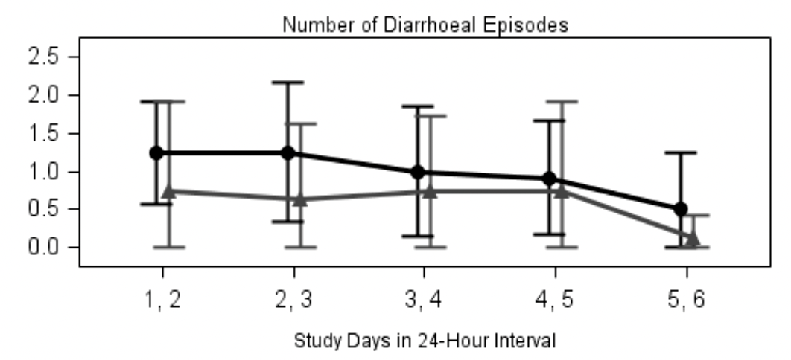
What’s new with Cryptosporidium infection?
There is no still highly effective, pathogen-directed treatment for Cryptosporidium-related diarrhea in setting of HIV
In Malawi, clofazimine was studied in RCT based on in vitro activity
No difference in diarrhea resolution→
Current therapy: rapid ART
initiation (consider as inpatient)
w/ treatment of electrolytes
derangements, dehydration
Median time to resolution with ART is 6 weeks (range 1-15)
Iroh Tam et al. 2021 CID. Carr et al. Lancet 1998
Notes:
What is new with the other big driver of chronic diarrhea in AHD, cryptosporidiosis?
Remember these patients will have watery diarrhea, typically no fever (check), and in the stool there are:
Cite Lancet article Signal of possible harm with 3 deaths in clofaz group and significant Aes
Dear Dr Tam,I had a question about your very important trial of clofazimine for cryptosporidiosis in CID. I was curious about the prevalence of Isospora belli that was found in the study participants for a talk I am giving to South African clinicians in the fall.
thanks Richard Murphy (Dartmouth)

Slide 15
Pitfalls when managing chronic diarrhea in HIV
Not sending stool for appropriate stains, incl. MC&S and mod. auramine stain
Not deploying empirical cotrimoxazole in HIV-associated chronic diarrhea without a diagnosis
Not considering GI TB in patients with chronic diarrhea especially those with fever in high TB prevalence regions; also consider CMV colitis
✓urine TB LAM, CXR, sputum Gene XPERT, abd U/S, myco. blood cultures
Discharging patient with ongoing diarrhea after initial rehydration with undefined plan for ART initiation
Chronic diarrhea in AHD is indication for urgent ART, if possible in-hospital
Adopted from Stead et al. SAHCS 2022 Adult AHD Guidelines
Notes:
Also consider endoscopic evaluation if initial studies not revealing and patient has persistent symptoms.

Slide 16
What are current outcomes of people with advanced HIV after hospital discharge?
A recent meta-analysis shows that post-discharge mortality remains high in Africa (23%) vs USA (7.5%)
No difference was found in proportion of patients who died following discharge
comparing studies published before 2016 and studies published after 2016.
Linked to care after discharge: overall pooled proportion of 42%
Ford N, et al. Lancet HIV 2022 Bossard, et al. J Acquir Immune Defic Syndr 2021
Notes:
So to come back to post- hospital outcomes in patients with OIs, post-discharge mortality in Africa remains >20%
But I am optimistic. There is now a fast track to ART initiation for patients with CD4<200 and same day ART init. is now common at all CD4 counts.
I think with the wider use of DTG-based therapy the total bucket of patients at risk for developing advanced disease will diminish
On the upstream side reducing stigma and refining innovative care models with attention to quality will be critical.
On the downstream side better access to optimal OI treatments is a moral imperative. And we are also looking forward to some RCTs that are studying how best to link discharged patients to timely follow-up HIV care. I would love to hear your ideas as well because fresh perspectives on this intractable problem may be one of the keys to putting an end to this stubborn scourge. So more to come and I’d love to update you in a couple of yrs.
With more efforts to end stigma, develop innovative care models and quality improvement in clinics as well as improving access to effective OI therapy and post hospital care linkage for those who do fall through the tracks we will go a long way towards reducing HIV related mort. In the years ahead.
Unfort. post d/c mortality remains high in African settings at 23% over 3-6 months and 8% in the US
However there are some promising changes.
There is a fast track in S Africa for those with advanced HIV to start ART urgently
But additional efforts are needed both upstream and downstream to reduce number who develop AHD including improving quality of care and introducing innov. care models. Downstream we need to improve access to optimal therapeutics for OI and improve our mgmt of patients in the vuln. period post d/c
We are considering novel ways to deliver ART to pts with neurologic Ois such as injectable ART but we need more creativity in thinking about avoiding complications of HIV in the decade to come.
READ
Going forward
Considering use of injectable ART in patients with neurological OI given cognitive barriers to optimal adherence
There is an RCT that will assign patients lea
DTG promises to reduce risk of treatment failure bc more potent and better tolerated.
There is much work to be done on stigma, particularly in men to help prevent late presentation + poor care engagement
Further research is needed to identify feasible approaches targeting individuals at highest risk of poor outcomes
after discharge and to provide adapted support to ensure appropriate linkage and continuity of support post discharge, including ART.

Slide 17
Post-discharge trajectory of
patients with advanced HIV
29% Died Prior to ART
41% Initiated ART
Months After Discharge
2
4
6
Discharge to death:
median 95 days
29% died + 9% lost to follow-up = 38% poor outcomes
Sunpath H et al Int J TB Lung 2011
Notes:
Patients hospitalized with adv HIV are at particularly high risk of death: they often have uncontrolled viremia and an OI
Post hosp mortality can exceed in hospital mortality.
- Back in 2007-8, The outpatient ART clinics were not set up for patients recently discharged with OIs many of whom had experienced loss of functional capacity from the hospital stay and sometimes were neurologically impaired from diseases like CM, toxoplasmosis
The clinics also had a rigorous pre-ART training requirement consisting of 3 visits for education and ART readiness assessment
On the ground we hypothesized that these requirements functionally acted as a barrier for recently hospitalized patients and with some operational research we found that over the 6 m following d/c only 40% of the patients we sent home from the wards with advanced HIV who intended to start ART actually did.
- Another 38% died or were lost to follow-up.
- So we thought let’s offer ART to patients with OIs before leaving the hospital at a step-down center and determine if we can change this trajectory
We found that patients with advanced HIV after discharge entered on
Among those who did not start ART, most died but deaths did not occur early after discharge, most occurred >2 m later.
Presented an opportunity to design an intervention.
Our intervention was to use a nearby step-down center to provide early ART prior to discharge bundled with nutritional, psychological and social supprt

Slide 18
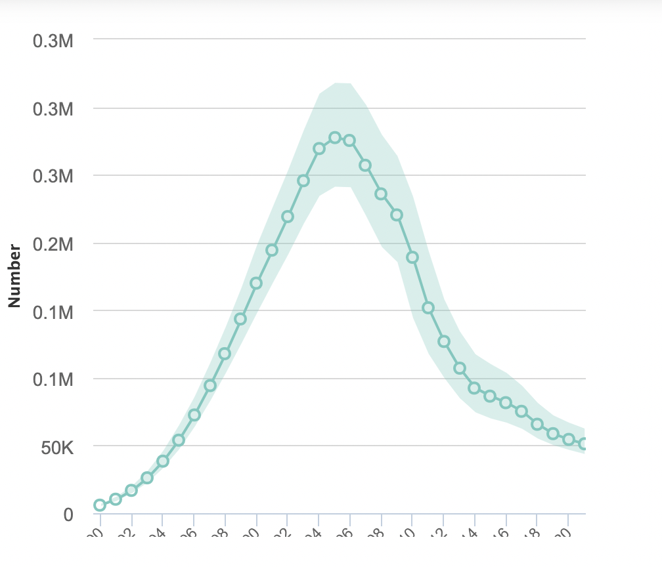
Advanced HIV is a stubborn issue
680,000 died from HIV-related illness globally in 2020, most with AHD
What is AHD?
CD4 <200 cells/mm³
or
WHO stage 3 or 4 event
↑ OIs, ↑ HIV-related cancers, ↑inflammation, ↑ organ failure
viremia
AIDS-related deaths in SA 2021: 51,000
down from peak in SA 2006: 280,000
UNAIDS 2022 : www.unaids.org/en/regionscountries/countries/southafrica
Notes:
Advanced HIV has become a very persistent issue around the world
Despite the success of the ART rollout, SA still sees 50,000 deaths / year as complication of HIV which while better than 10 yrs ago is unacceptably high
The term AHD is replacing the more stigmatizing terminology AIDS; a person has AHD if the CD4<200 or if he or she develops a new OI like TB
It has known since the START study more than a decade ago that if you wait until AHD develops before starting ART (compared to starting at a CD4 count > 500) that patients have a increased mortality not just from infections but from cancers, organ failure, MI. Late ART initiation remains a problem in the US as well.

Slide 19
AHD still common in community and underestimated
Household level study Eshowe (S Africa) Chiradzulu (Malawi), Ndhiwa (Kenya):
Adv HIV prevalence in those HIV (+): 10% S. Africa, 8% Malawi, 12% Kenya
Men 2x as likely to have AHD
Overall >50% with AHD not on ART :
not yet diagnosed w/ HIV
diagnosed but not in care
Stigma, fear of discrimination and abandonment remain key themes in qualitative research leading to:
Delayed testing
Nondisclosure or selective disclosure
→ Delayed (or no) care engmt.
Eshowe, South Africa
Madiba et al. Health Care 2021
Chihana et al. Global Health Action 2019
Notes:
Clinic-based and hospital-based studies have typically been used to estimate the burden of advanced HIV in a particular area
But this was a survey done at the household level designed to capture patients not in the healthcare system in a rural area of SA.
It found that in Eshowe, SA, which a Zulu community not far from Durban, that the prevalence of HIV was about 25% and prev. of AHD was about 10% of the community.
Men were more likely to have adv disease by factor of 2.
More than half of those with adv HIV were not on effective ART because not diagnosed, not in care or failing ART.
Those with AHD fell in 3 categories: 1/3 not even diagnosed and therefore not on ART, 1/4 were diagnosed but not on ART and 40% with adv HIV were on ART although ¼ in that group were failing ART.
Stigma is an important reason men present late to care. It is still a powerful force that inhibits particularly men from getting test and engaging in care
Now this survey was done in 2013 but I believe there remains a large burden of unidentified AHD in the community.

Slide 20
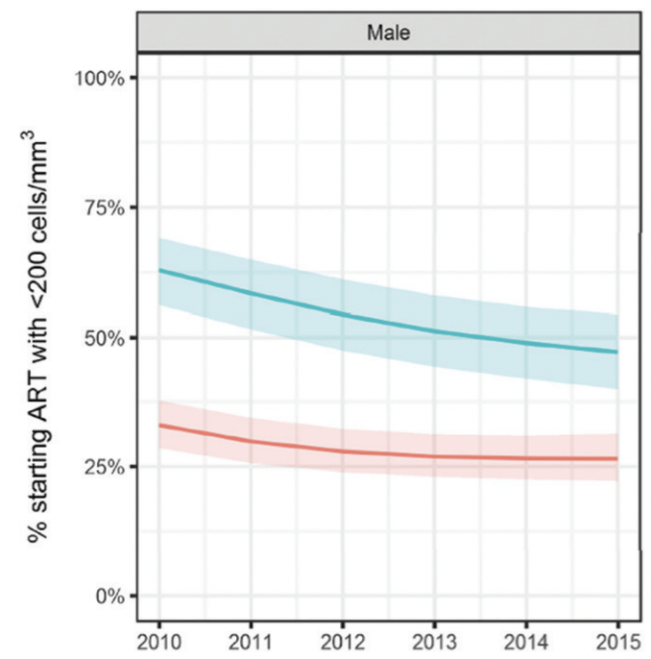
A significant proportion of patients still start (or restart) ART with a CD4 <200
ART-naïve
30–40% of people living with HIV starting ART in low-income settings have a CD4 <200
20% have a CD4 <100
ART-experienced w/ treatment failure
In African settings, pooled mean CD4 count at ART failure was 187 cells
Pooled mean CD4 count at 2nd line switch was 108 cells
Low income
High income
Bernabe K. Open Forum Infect Dis 2022. WHO Advanced HIV Guidelines 2017
IeDEA/COHERE–WHO Collaboration
Notes:
VF in Africa remains an event recognized late in HIV infection, a problem compounded by ongoing delays between VF and second-line switch.

Slide 21
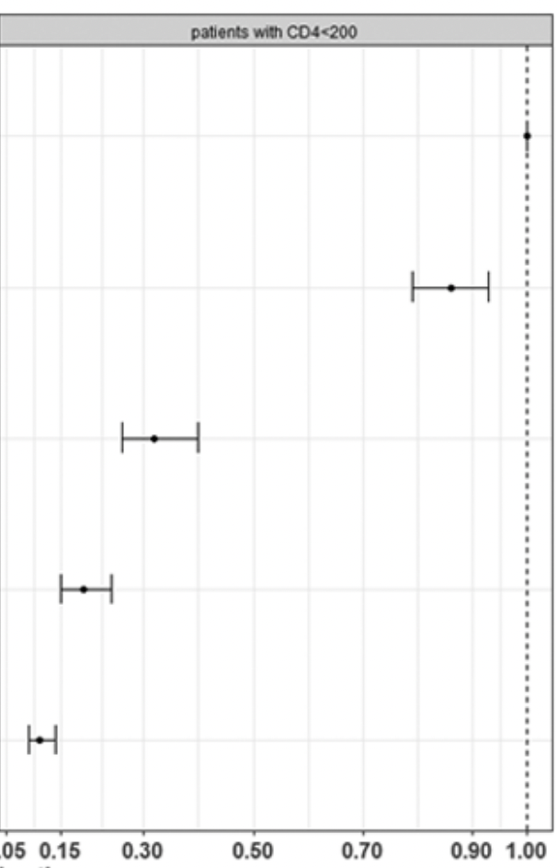
Advanced HIV also develops in patients on ART
Switch delay after VF and risk of death
Yearly viral load (VL) → VL >1000 c/ml → adherence support → repeat VL in 3m → VL >1000 → 2nd line ART
Study of monitoring gaps in Cape Town cohort:
Time to confirming virologic failure and time to switch to 2nd line was median ~6m (not 3m) and ~13m (not immediately after 2nd VL)
Patients switched promptly after ART failure had a 90% reduction in subsequent mortality
No switch
>90 days
60-99 days
30-59 days
<30 days
Hazard ratio of death
Lowest risk of mortality after virologic
failure if rapid switch to 2nd line ART
Sunpath et al. Public Health Action 2018. Moyo et al. Clinical Epid 2016. Gorrod et al JAIDS 2020
Notes:
Advanced HIV also develops in patients receiving ART in active clinic follow-up. How?
In monitoring patients receiving ART, clinics are supposed to follow an algorithm.
A patient on ART should receive a yearly viral load. If VL >1000, the patient receives adherence support and VL is rechecked at 3 months. If VL remains > 1000 , the patient should be immed. Switch to 2nd line ART. If this doesn’t happen patients experience persistent treatment failure and are at risk for immunologic deterioration.
We found in a recent study with collaborators from Univ of Cape Town that there are major gaps in this cascade.
Time from 1st elev VL to confirmed was 6 m not 3
Time from confirmed failure to switch to second line ART was 13 m not immed.
We found that for patients experiencing treatment failure, the amount of delay before 2nd line ART had a survival impact.
In contrast to those delayed 3 m or more, patients switched <30 d after confirmed virol. failure had a 90% reduction in subsequent mortality
Viral load monitoring underutilized
In public HIV clinics, viral load tests received when indicated only ~60% of time
When elevated, key steps do not reliably occur – adherence support, repeat VL, 2nd-line switch – leading to CD4 decline
SA Private sector has the same problem. We did a study 2 years ago which showed that missed treatment failure and delayed switch lead to avoidable mortality. Those with treatment failure switched rapidly had 80% less risk of death compared to those with ART failure whose switch was delayed >90d
Currently an RCT in progress to see if this can be improved using a quality improvement package
Compared to patients with treatment failure with delayed switch >90 d after virologic failure or not switched, those switched within 30 d had a 80% reduction in risk of death.
There is poor viral load monitoring and inadequate management of virological failure in individuals on ART with only about ½ of patient benefiting from timely viral load testing.
We did a study 4 years ago which showed that patients in clinic on ART rec’d VL on time only about 60% of time. Fortunately we found that most of those patients were suppressed but when pts were not suppressed the other problem was that elev VL did not lead to action.
The research of Henry Sun path had been very informative in showing that AHD is also present in patients in engaged in care who are experiencing unrecognized VF.
VL monitoring has been underutilized resulting in missed recognition of treatment failure.
Further once established switch delays have resulted in poor outcomes in all patient groups including adv. HIV. Patients not switched after failure had the worst outcomes with risk of death declining as the delay prior to switch shortened.
We showed that in the SA private sector – where the median time to 2nd line switch after confirmed failure was more than 6 months -- that delaying switch to second line ART increased risk of death, with those switch less than 30 days after confirmed failure doing the best. *Was
Patients interrupt HIV care / antiretroviral therapy
Not all persons treated for HIV achieve durable viral suppression. (Global health action chihana et al)
Treatment failure is missed in clinics where VLs are
Considerable delays before 2nd line switch
We showed that outcomes identified with AHD at failure were considerably worse that those identified earlier

Slide 22
Invasive fungal infection

Slide 23
Patient
36 M with HIV admitted with cutaneous nodules
12 wks prior to presentation started ART
4 wks prior developed rash and a few days before admission became confused
Febrile, encephalopathic. + oral thrush. Flesh-colored nodules scattered on face & chest w/ erosive lesion on forehead
CD4 14
CXR normal. U/S: Abd LAN and HSM
Serum CrAg (-). Normal CSF cell count, pressure, chemistry
A skin biopsy was obtained
Rodríguez-Cerdeira C, Actas Dermosifiliogr.2014;105:5---17
Notes:
Read case
The patient was placed on 200 mg daily dose of fluconazole (for candidiasis), and he received
high-dose cotrimoxazole as treatment for suspected central nervous system toxoplasmosis. A skin biopsy was obtained. The patient deteriorated rapidly within 24 hours of admission, with the
development of hypotension and worsening mental status, and
he died.

Slide 24
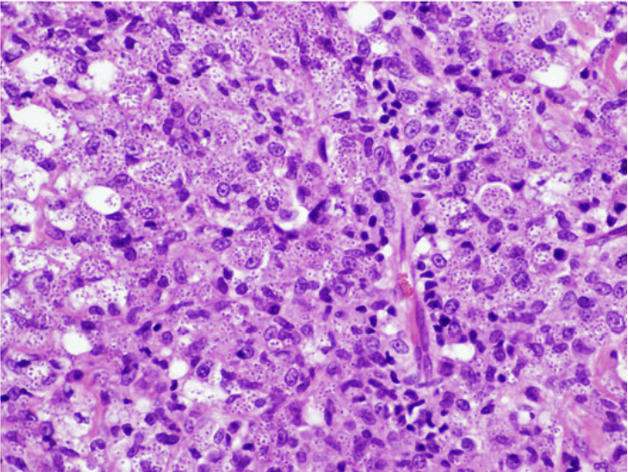
What is the diagnosis?
a. Disseminated cryptococcosis
b. Molluscum contagiosum
c. Disseminated histoplasmosis
d. Disseminated emergomycosis
e. Invasive aspergillosis
f. (c) or (d)
Innumerable small ovoid yeast-like organisms measuring 2–4 µm in diameter.. Clear halos surround many of the organisms.
Notes:
Summary young man with CD4 14, ill with fever, nodular rash, HSM and normal LP
Unlikely to be disseminated CM with negative CrAg
Molluscum does not cause encephalitis and fever with systemic illness
Fever, nodular/ulcerative rash, splenomegaly, advanced HIV. Very likely
Possible because histo and Emergomycosis are virtually indistinguishable clinically and histologically
Aspergillosis would not appear as yeast and does not commonly cause skin lesions in adv HIV, occas pulm disease

Slide 25
New WHO guidance on histoplasmosis in HIV
Recommended test: urine Ag; 95% sens. in adv. HIV
POC test still needed; lateral flow assay may be avail. soon
Initial therapy for disseminated histoplasmosis: polyene
(i.e. if vital organ involvement, poor functional status or CNS involve.):
Preferred: Liposomal amphotericin B 3 mg/kg IV for ~2 wks
Alternative: Amphotericin B 0.7-1 mg/kg IV for ~2 wks
Step-down : Itraconazole 200 mg PO TID x 3 days→ BID for 1 year
Consider <1 yr if clinically stable on ART with CD4 improvement and VL UD
ART: If tolerating therapy start ART “as soon as possible;” IRIS rare
No major DDIs btwn. itraconazole and dolutegravir / TLD
Univ. of Liverpool Drug Interactions Checker WHO 2020 Diagnosing and Managing Histoplasmosis in People with HIV
Notes:
READ
When start ART?
Prior to treatment for histoplasmosis
Simultaneous with histoplasmosis therapy
As soon as therapy for histoplasmosis tolerated
Wait 5-6 weeks before starting ART to avoid IRIS

Slide 26
What is the reality on the ground in South Africa?
Histoplasmosis urine Ag not widely available
Available at some referral sites
L-amphotericin not routinely available
In S. Africa limited to certain patients (ex., w/ existing renal injury)
Itraconazole available as capsule but not the more patient-friendly itraconazole solution
Capsule less well-absorbed (and have food / gastric pH requirement)
Lack of therapeutic drug monitoring makes use of capsules challenging
Discussion with Prof. Yunus Moosa, 2022 Johns Hopkins Antibiotic Guide, 2022
Notes:
READ
Low itraconazole concentration associated w/ failure, high w/ toxicity
Reality in SA:
Histo urine Ag: The NICD exploring the possibility of offering the test. Not available now
Liposomal amphotericin – available but very restricted- Require to use Deoxycholate 1st and only if trouble to motivate LAMB.
Itraconazole – accessible but often out of stock and a real schlep to use. Only tablet, no syrup (which is better absorbed if I remember well) available. TDM not available so it’s a risky choice.
On about 5% of those with disseminated histo have CNS involvement.
Initial therapy in mild or moderate disease:
Itraconazole 200 mg PO TID for 3 days and then 200 mg PO BID
Fluconazole less effective

Slide 27
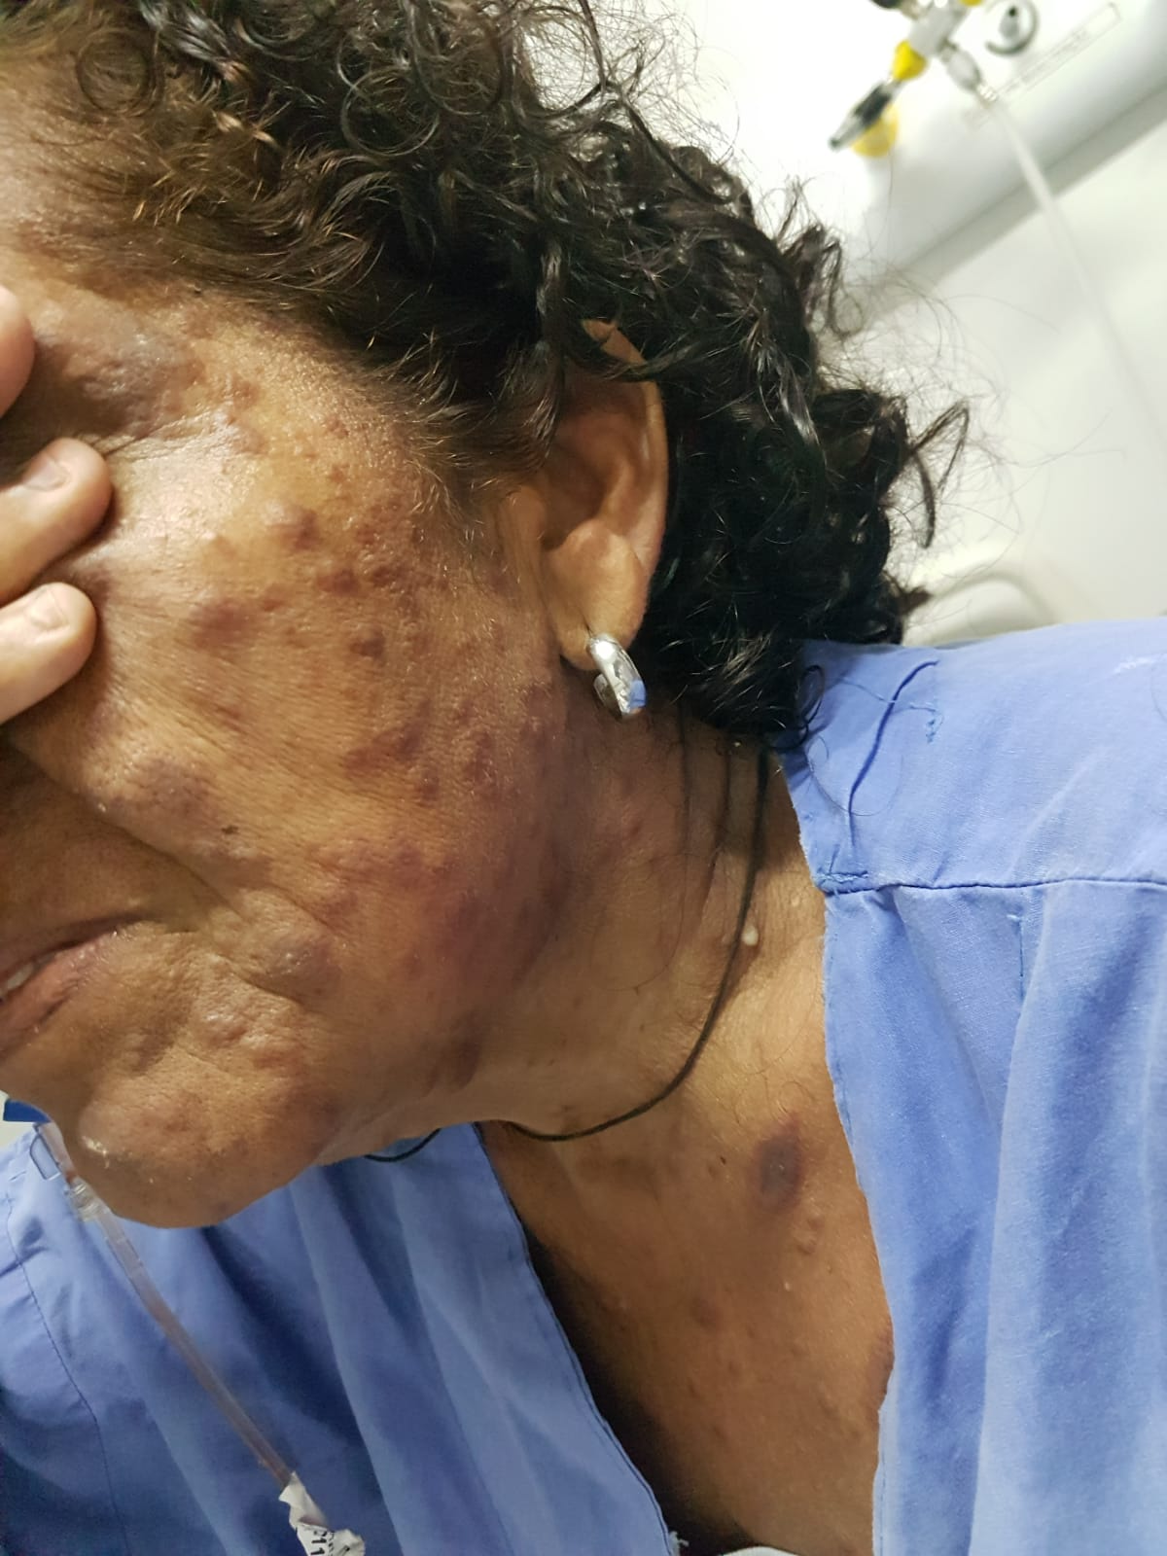
High-dose L-AmB in disseminated histoplasmosis
Phase 2, open label RCT in Brazil; HIV-associated disseminated histoplasmosis randomized to one of three arms including L-AmB 3 mg/kg for 14 days or to L-AmB 10 mg/kg x 1
- Excluded CNS disease, pts expected to die <48 hrs
N=118, median CD4 ~25
Clinical response* D14 survival
L-AmB X 1 dose 82% 90%
L-AmB X 2 wks 72% 90%
*Resolution of fever and other symptoms (not skin lesion)
Less renal toxicity observed with single dose L-AmB
Overall survival was similar at 1 year by K-M analysis
Pasqualotto A, et al. IDWeek 2022
Notes:
Recently some encouraging findings were presented at IDWeek using a strategy of single high dose liposomal amphotericin.
High single dose L-AmB used with success in visceral leishmaniasis and CM but not in disseminated histoplasmosis.
Diss histoplasmosis also an important killer in adv HIV in South America, southern Africa with up to a 40% mort in adv HIV.
Despite guidelines recommending L-AmB for 2 weeks, many patients treated in that region much longer than that with considerable toxicity.
READ
This is a presentation from a recent conference so I look forward to seeing more details and longer outcomes in the full report but certainly encouraging.

Slide 28
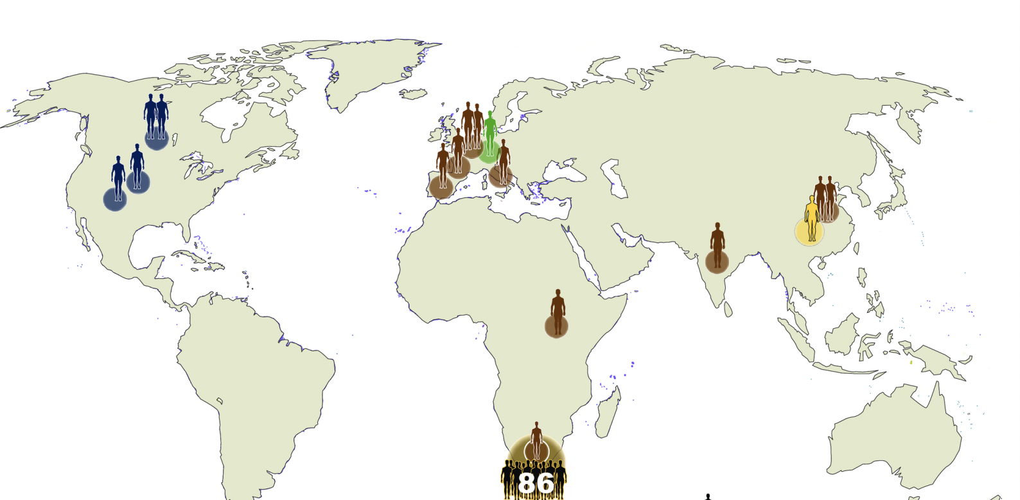
What about emergomycosis?
Invasive fungal infection assoc. w/ HIV described in 2013
Dimorphic fungus =yeast in tissue (like histoplasmosis) first seen in patients in Cape Town
Cases now reported outside S Africa
Clinical features also very similar to histoplasmosis. Papules, nodules that ulcerate common, med. CD4 <50
If path/micro available: biopsy for histology & culture
Can cross-react on Histoplasma urine Ag assay; 30% of emergomycosis Histoplasma urine Ag (+)
Trials lacking but patients typically respond to amphotericin B; itraconazole maintenance is given for up to a year, as in disseminated histoplasmosis
Young woman (Lesotho) with advanced HIV
presenting with fever, weight loss and rash
with presumed emergomycosis
Emergomycosis cases, 2019
Madani et al. SA J of Inf Dis 2022 Schwartz et al. Open Forum Inf Dis. 2017. Schwartz et al. PLOS Path 2019 Kenyon et al. NEJM 2013
Notes:
READ first
Conidia on narrow pedicles in the lab.
Oval yeasts have narrow based budding
This woman did not have disseminated disease. Started on flucon 400/day and had no response but responded to itraconazole.

Slide 29
PJP

Slide 30
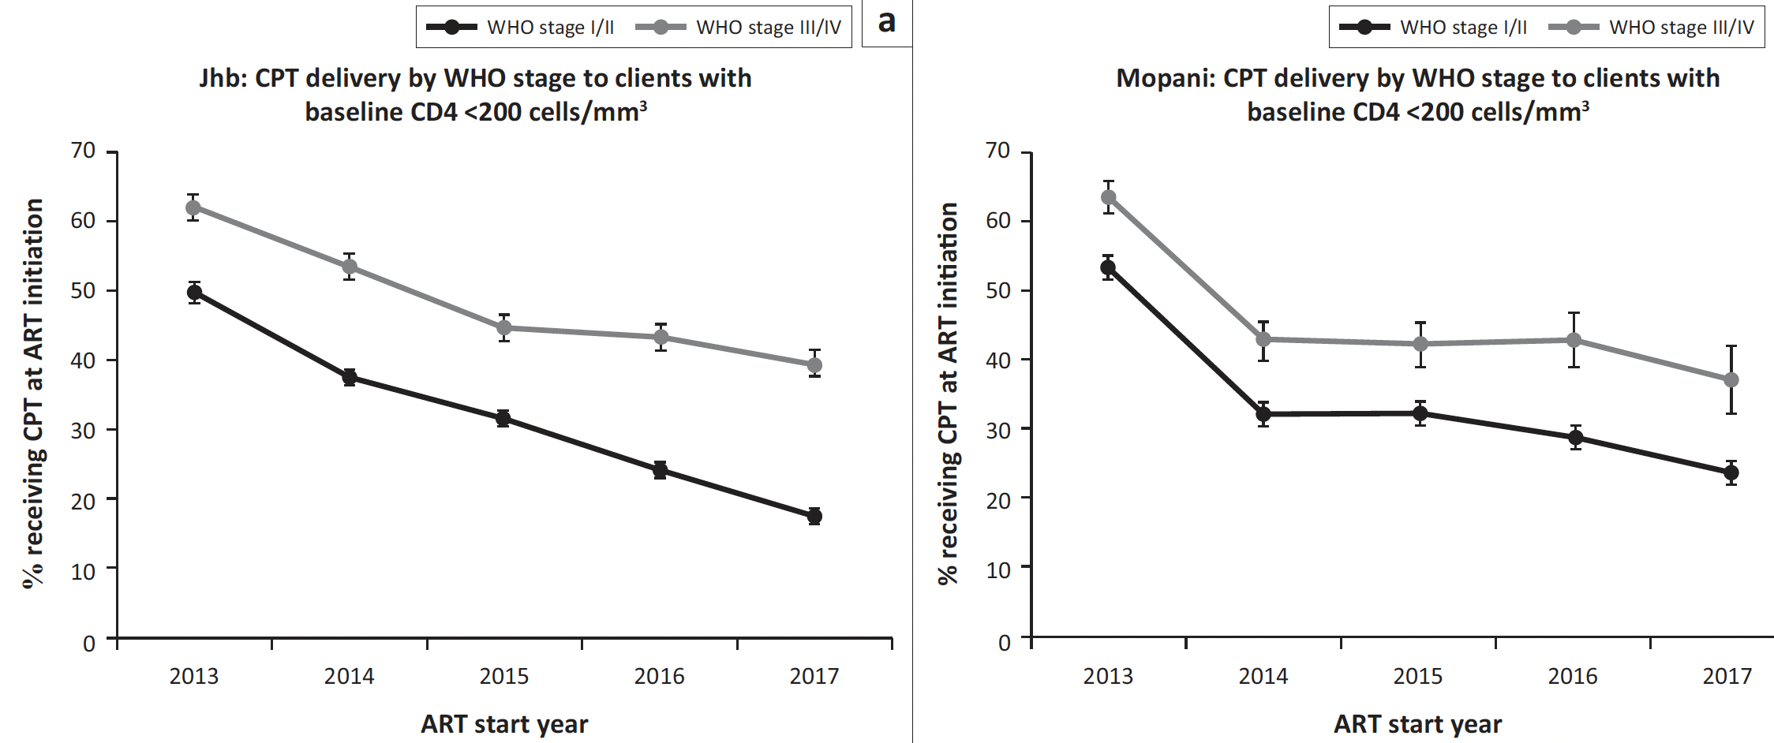
What’s new with PJP? Use of TMP/SMX preventative therapy too low
TMP/SMX recommended if CD4 <200 at 1 DS 160/800 mg/day
However utilization in this patient group in S. Africa declining
Lilian RR, et al S Afr J HIV Med. 2019
Notes:
In many parts of the world patients eligible for TMP/SMX prophylaxis incl in the US do not receive it or do not take it.
These data show that the use of CPT in patients with CD4<200 who would benefit is declining, particularly in those with WHO state 1 or 2 disease (ie patients who may not appear as ill) in both urban and rural areas of SA.
In the US we discontinue primary PCP prophylaxis in patients who are receiving ART and have an undetectable viral load if the CD4 count >200 for 3 months or for those who are on ART and achieve CD4 100-200 with long-term suppression and SA has similar thresholds.
In case you have not followed this field closely, we are not longer recommending prophylaxis for MAC in patients with advanced HIV if they will be initiating ART immediately & rest of the world never did utilize MAC prophylaxis.

Slide 31
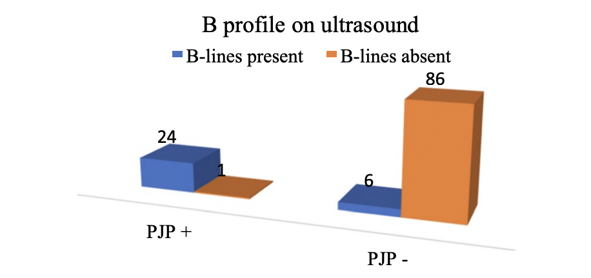
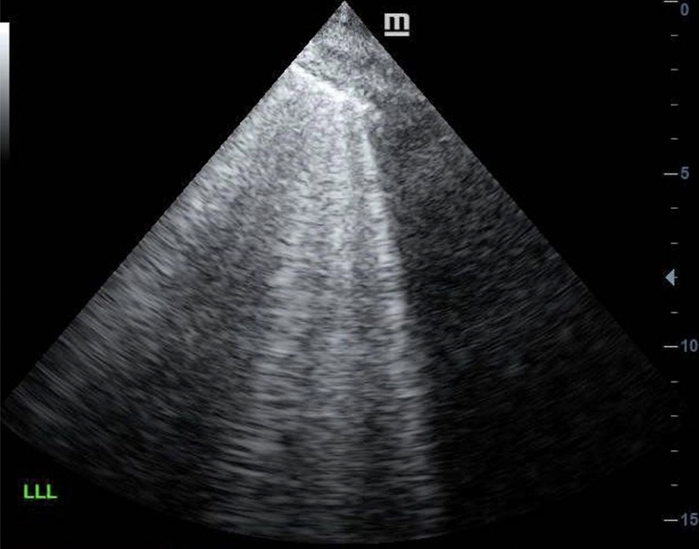
Severe HIV-associated pneumonia –- South Africa
Recent Pretoria study of patients w/ HIV + severe pneumonia
Median CD4 ~120, 1/3 on ART, 50% ICU
Diagnostics avail. incl bronchoscopy with BAL with PJP PCR (via NHLS)
TB 35%, PJP 21%, bacterial PNA 17%
U/S: B-lines associated with PJP
95% w/ PJP had B-lines (high sensitivity)
Useful tool but non-specific: B-lines also seen in viral PNA, CHF
Ueckermann et al. BMC ID 2022
Notes:
They propose an U/S finding that is sensitive for PJP which are lung B lines.
B lines are vertical hyperechoic bands arising from the pleural line + extend to bottom of the screen w/o fading linked with alveolar-interstitial syndromes. In their study 24 of 25 with PJP had Blines. Also in viral PNA and CHF but in the right setting it seems like a inexpensive and nice new POC too.
PJP is still largely diagnosed clinically both in the US and overseas but the difference is that in the US we have tools to confirm diagnosis namely bronch with BAL with sample sent for immunofluorescence assay or staining
Advantages of PCR is that it is a sensitive tool for detecting PJP but difficult to separate infection from mere colonization.
If not present, unlikely to be severe PJP
? 1-2 B lines can be normal but 3-4 not

Slide 32
Cryptococcal disease

Slide 33
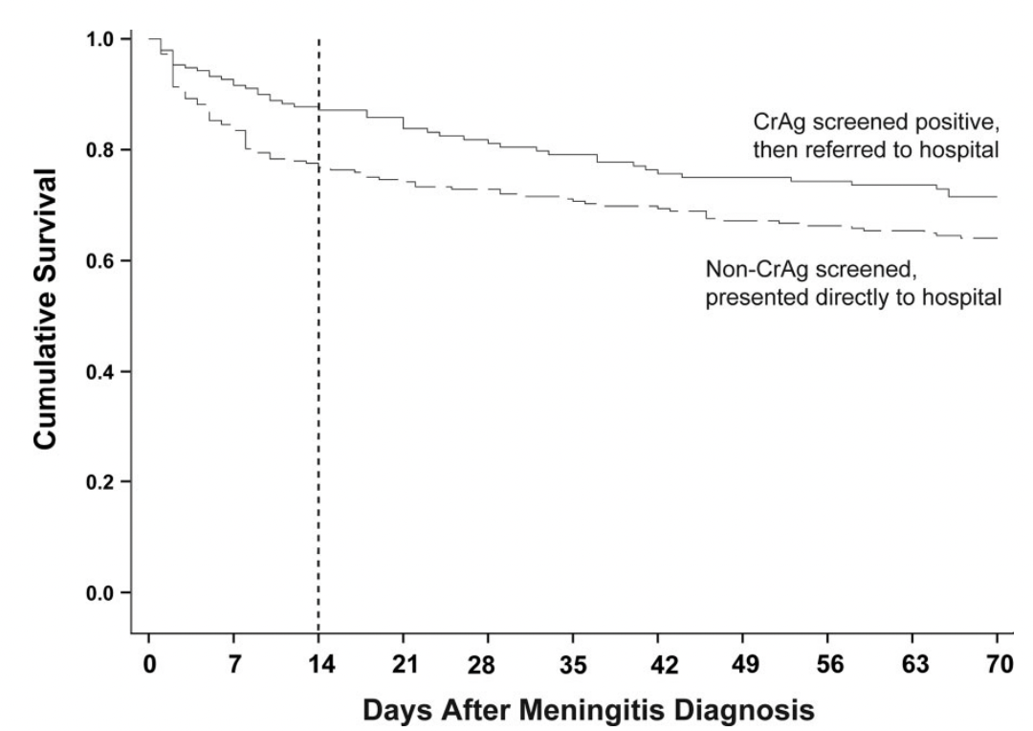
Cryptococcal Antigen Screening Linked with Favorable Baseline Characteristics and Improved Survival
Prospectively (N=489) compared survival between those diagnosed w/ CM (1) referred to hospital due to (+) CrAg (40%) vs. (2) presenting directly to hosp. (60%)
Only those with symptoms underwent LP and initial treatment consisted of AmB + fluconazole
There was reduced mortality in CrAg-identified patients →
Why? Groups similar in baseline CD4, baseline ART use, proportion with CSF WBC <5 cells/uL
but….
CrAg-identified participants:
Less likely to have altered mental status (29% vs 41%)
Had ↓ quant. CSF culture (4570 vs 26,900 CFU/ mL)
Had lower opening pressure
14 d mortality was better in CrAg screened and
remained better at 10 wks (24%) vs those
presenting directly to hosp. (32%). ( P =.04)
Levin et al. CID 2022
Notes:
Reflex cryptococcal antigen screening is now performed in many countries because subclinical infection precedes symptomatic cryptococcal meningitis and majority who screen positive and do not received treatment die within 2yr
In South Africa which performs screening in those with CD4<100, the prevalence varies by region but is up to 9%.
In E Africa, it is 8%. About 1/3 of patients with a positive serum CrAg and no sxs DO have meningitis ID’ed at LP.
But there has been little about how patients found thru screening who still develop meningitis compare to those admitted with CM in terms of outcome, data which are impt in defining the ongoing impact of this screening program.

Slide 34
Managing ART in patients admitted with CM
Prospective cohort study at 3 hospitals in Uganda (n=724) of patients with CM
Patients came from a variety of studies including the AMBITION-CM trial, 2017-2
ART mgmt. was standardized:
ART-naïve
Deferred ART until 4-6 w
On ART but likely failing
Stopped ART, restarted at 4-6 w
Recently started on ART <6 m
ART continued
Rhein et al. OFID 2018. Cheng et al. IDWeek 2022
Notes:
In the past, most patients diagnosed with CM were ART naïve.
The management of ART naïve patients is informed by the landmark COAT trial which showed a mortality benefit with delaying ART for 5 wks. particularly in patients with pauci immune CSF response to CM.
However, a substantial proportion of patients with CM are not ART naïve and the best mgmt. of this group is unk.
Should ART be continued if recently started? Should ART be stopped and restarted in 5 wks? Does it depend on how long they have been on ART ?
Prior data from Uganda showed that early mortality from CM did not differ between ART–naïve and ART–experienced: 2wk. mort: 27% in both groups
But in ART-experienced, 2 wk mortality differed by ART duration: <14 days (47%), 15-182 days (19%), >6 m. (26%)
Conclusion: Early “unmasking IRIS CM” has high mortality but study did not provide evidence on managing ART

Slide 35
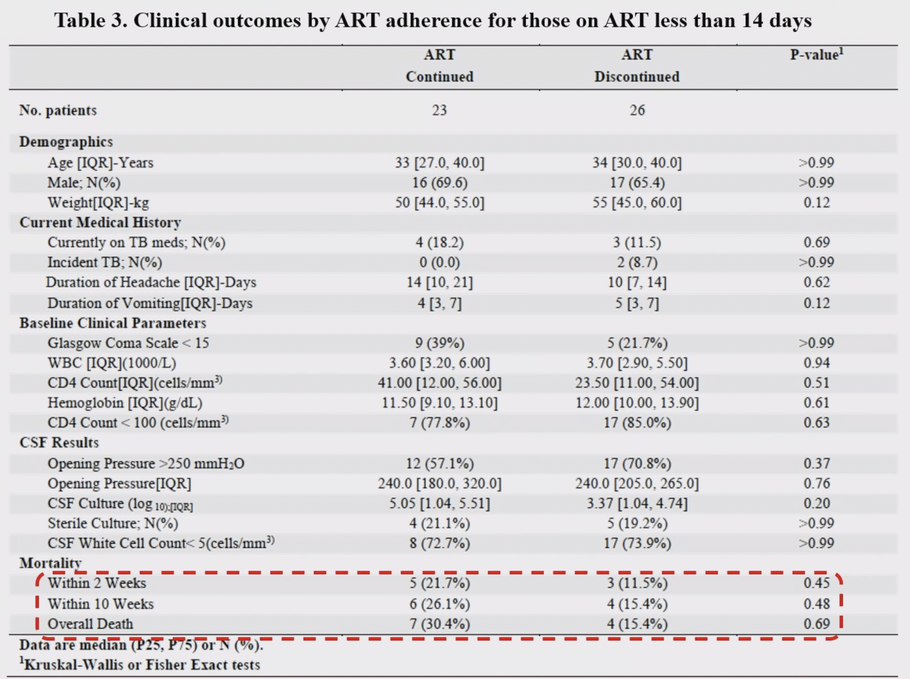
Managing ART in patients admitted with CM
*BUT if on ART<2 wks, physician discretion
used to determine to continue/stop ART
Results:
Patients w/ ART experience had
higher CD4 and lower fungal burden
No overall mortality differences
between ART-naïve and ART-experienced
But in those on ART <2 wk, continuation of ART linked with 2X
higher mortality compared to stopping: 30% vs 15% (n=49, NS)
Notes:
For patients with CM who very recently initiated ART and are unlikely to be virologically suppressed, consideration should be given to stopping ART and restarting 4-6 weeks later.
Numbers are low but perhaps immunologically, this group may have more in common with ART naïve patients and therefore should be managed like ART naïve patients and have ART deferred.

Slide 36
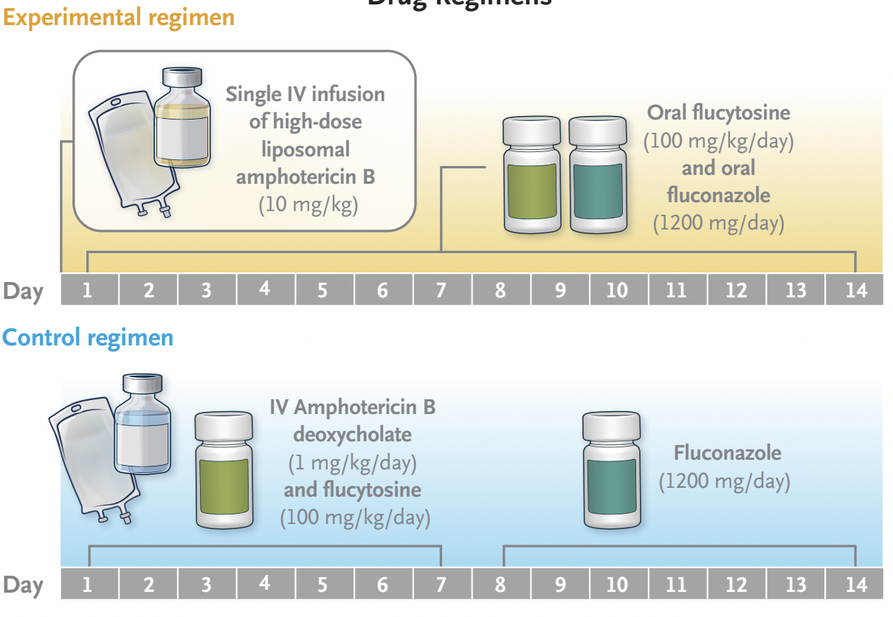
Single dose L-AmB for cryptococcal meningitis
Patients w/ crypt. meningitis in Africa by CSF CrAg or (+) India Ink
Non-inferiority open label trial,, primary outcome mort. at 10wk
Med. CD4 27, 2/3 ART-experienced
Daily LPs for ↑ICP
At week 10, 25% died in the single dose L-AmB group and 29% in SOC meeting non-inferiority (P<0.001)
With single dose L-AmB rate fungal CSF clearance equivalent
L-AmB had fewer high grade AEs
Drug regimens
The WHO recommends this regimen (2022):
But, access to L-AmB and flucytosine is difficult – cost is limiting implementation
Jarvis NEJM 2022
Notes:
What about initial treatment for those found to have progressed to CM
Given the toxicities of SOC treatment of this disease, namely renal toxicity and anemia from standard formulation AmB deoxycholate, investigators decided to test liposomal Amb given as a single dose on just one day in 3 African countries vs the current WHO preferred regimen in which standard amphotericin B given for 7 days. The single dose was studied because L-AmB has a long tissue half life and L-AmB does penetrate brain tissue effectively. If single dose effective it could also result in use of less L-AmB and potentially a shorter hosp. stay.
READ
Chose this because they want to show that experimental arm is not a lot worse in terms of efffic because they knew it had many potential adv in terms of safety, length of stay and possibly cost and did not expect better effic.
Current recommended treatment in settings without access to liposomal formulation of amphotericin such as southern Africa is amphotericin B deoxycholate (the original formulation) plus flucytosine for 7 days.
However the toxicities of this older formulation of amphotericin are significant and mortality remains high currently both during hospitalization and after d/c.
In this study this SOC was compared to liposomal amphotericin given not daily but as a single high dose. Since L-AmB has a very long tissue half life and effectively penetrates brain tissue it was thought that this would be a better strategy.
READ
Single dose liposomal amphotericin B was considered a good candidate to shorten treatment for CM because it can be given at higher doses owing to a lower incidence of adverse effects, has a long tissue half-life and effectively penetrates into brain tissue.
READ
But patients with advanced HIV experience significant morbidity from the treatment itself.
Amphotericin B, the old formulation has impt AEs – nephrotoxicity, electrolyte loss, anemia – and the developed world shifted a decade ago to the liposomal formulation but cost has made access impossible for most of the world.
Current SOC in SA is 1 weeks amphotericin B deoxycholate + flucytosine, with the flucytosine made available through a DWB access program
This study sought to see if a single dose of L-amphotericin B because of its long half life may provide antifungal efficacy with fewer electrolyte and renal function disturbances, and anemia
If it proved successful not only would it provide a safer alternative but it would potentially shorten hospitalizations and reduce the amount of drug used

Slide 37
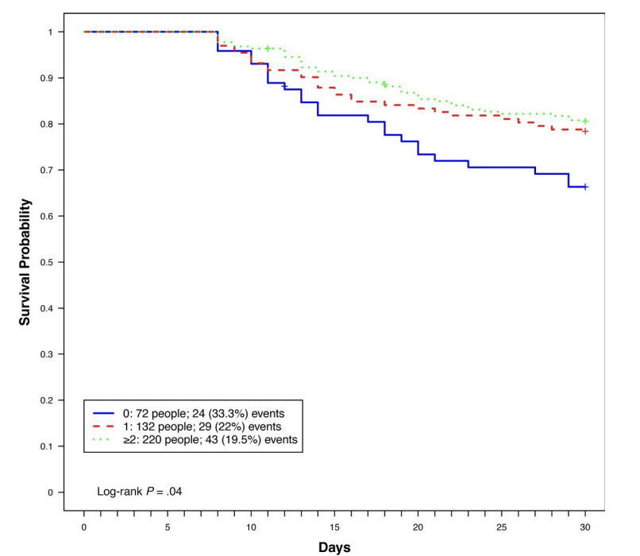
Therapeutic LP in HIV-associated Cryptococcal Meningitis: Should Opening Pressure Direct Management?
This was a substudy of a prospective study of patients with CM in Uganda (2013-17)
Investigators sought to understand the relationship between ICP, therapeutic LP and survival
As expected, baseline elevated ICP >35 cm (350 mm) associated with worse outcome
But regardless of baseline ICP, receiving no additional LPs linked w/ higher mortality (33%) compared to 1 additional LP (22%) or >2 LPs (20%)
Authors: Following schedule of minimal follow-up LPs (ex., Day 0, 3, 7 and 14) may be helpful, regardless of opening pressure for biological + practical reasons
30 day mortality by number of follow-up LPs in
the first 7 days for those who survived at least 7 days.
Kagimu et al. CID 2022
Notes:
In the care for patients with CM, management of elevated ICP is consider critical in reducing symptoms and complications
Active management of elevated ICP improves survival.
Existing guidelines do not provide recommendations on repeated LPs in patients with OP less than 25 cm (or 250 mm) and this has been left to discretion of providers and in this setting repeated therapeutic LPs not normally performed.

Slide 38
Cerebral toxoplasmosis
Notes:
Everyone recall cerebral toxoplasmosis.
In HIV patients with prior toxoplasmosis exposure -- as evidenced by a positive IgG -- it can reactivate when CD4 falls below 100 resulting in brain abscess, often in the basal ganglia.

Slide 39
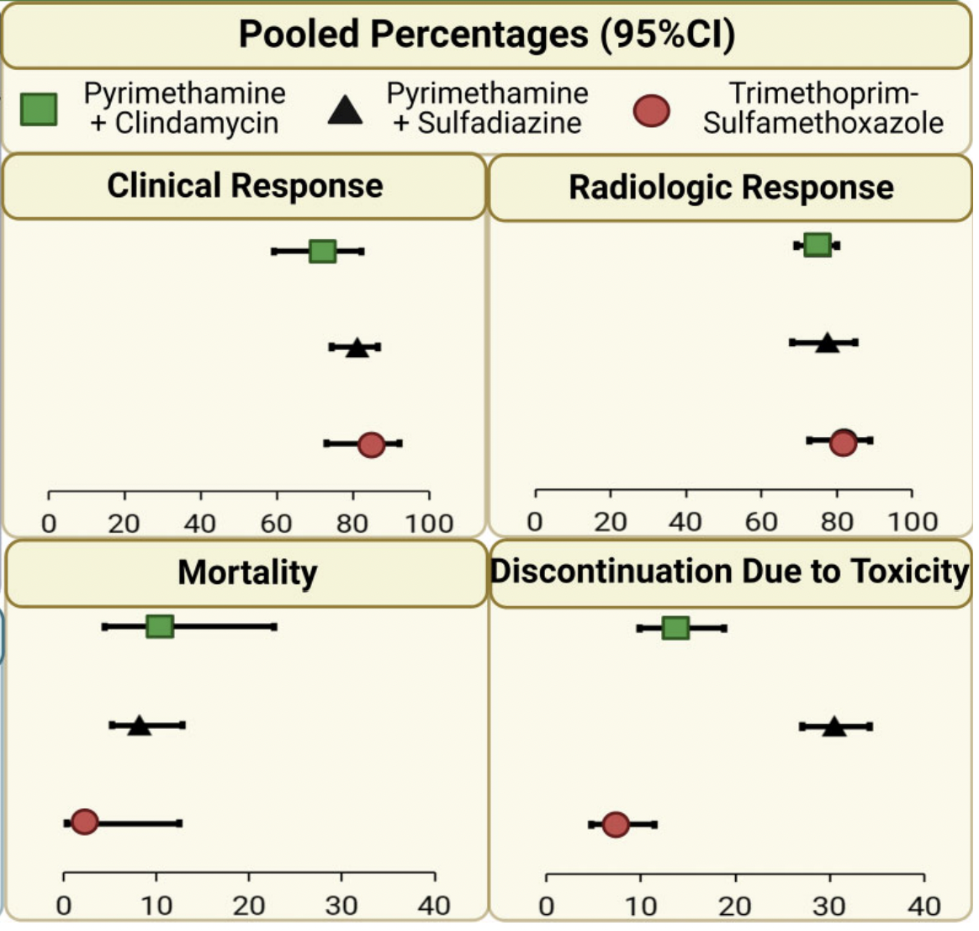
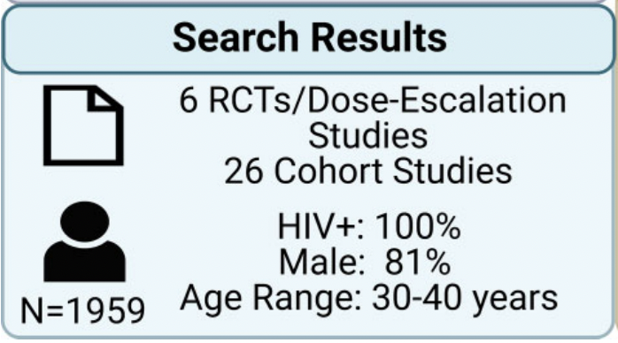
Meta-analysis: TMP/SMX vs. pyrimethamine + sulfadiazine for cerebral toxoplasmosis
As first-line therapy for TE, US-guidelines have recommended pyrimethamine/sulfadiazine
But difficult to administer (no IV formulation), more expensive and associated with adv. events.
Prosty et al CID 2022
Notes:
The US and Europe – for a long time -- have had better access to safe and effective drugs for OIs even though most of the burden has been and remains elsewhere which make one sick to one's stomach: L-AmB, flucytosine, rifabutin.
In the US, we’ve traditionally used for cerebr. toxo: pyrimethamine+sulfadiazine and it remains in all the guidelines incl UTD.
But if you remember, the price of pyrimethamine was manipulated for many years affecting access. Problems include lack of IV formulat.+AEs
In contrast in RLS for years, high dose TMP/SMX has been used as an alternative in cerebral toxoplasmosis.
This meta-analysis looked at 6 RCTS and 26 cohort studies and found that in terms of clinical and radiographic response TMP/SMX appears as effic. as pyrimethamine + sulfadiazine. Importantly it is safer with far fewer discontinuations resulting from toxicity .
So in TE high dose Bactrim appears to be as effective and SAFER. Plus it’s also less expensive, and much easier to take with both IV or PO options

Slide 40
ART in advanced HIV
Notes:
Everyone recall cerebral toxoplasmosis.
In HIV patients with prior toxoplasmosis exposure -- as evidenced by a positive IgG -- it can reactivate when CD4 falls below 100 resulting in brain abscess, often in the basal ganglia.

Slide 41
When to start: ART timing in advanced HIV
Indication | Action | Comment
PJP* | Start ART within 2 wks of PJP treatment or earlier | PJP IRIS not common
Chronic diarrhea* | Start ART within 2 wks but preferably ASAP | ART only effective Rx for cryptosporidiosis
Toxoplasmosis* | Start ART within 2 wks of TE treatment or earlier | TE IRIS not common
Drug-sensitive TB* | CD4 <50: Within 2 wks of TB treatment or earlier CD4 >50: Start ART at 8 wks, or earlier if tolerating TB treatment | Consider prednisone to reduce risk of TB-IRIS. For TLD, + addit. DTG 50 mg/day
Drug-resistant TB* | Start after 2 wks of DR-TB treatment or earlier DTG-based ART has multiple advantages. | If symptoms improving & tolerating treatment
CNS-TB (meningitis or tuberculoma) | Delay ART 4-8 wks
Cryptococcal mening. | Delay ART 5-6 wks | Delay especially impt. if CM assoc. w/ CSF WBC <5/mm³
*If hospitalized, consider an in-hospital start. 2019 SA ART Guidelines, SA DOH
Notes:
My approach to timing of ART in advanced HIV is straightforward:
If there is no current OI or OI has suboptimal or no treatment options like chronic diarrhea, very rapid start is reasonable and encouraged, incl in hospital if feasible
For patients with most Ois such as TB or PJP, I would recommend it be started as soon as a patient is stable on treatment for their OI, certainly within 2 weeks
For patients with cryptococcal meningitis esp those with evidence of poor inflammatory response in CSF of <5 or in TB-M, ART should be delayed for 5-6 wks.

Slide 42
NRTI and NNRTI Resistance in ART-Experienced Inpatients
Substudy of STAMP trial focusing on Malawi site; recruited HIV (+) patients admitted irrespective of presentation
N=1316 patients enrolled in Malawi
N=1108 of HIV (+) patients knew HIV status
N=1021 were on ART
N=815 on ART >6m, 98% first-line NNRTI-based ART
Among those receiving 1st line ART >6m, VL >1000 in 32%
92% had EFV resistance and >80% had NNRTI + NRTI resistance
Mortality by day 56 was 20%
1/2 of deaths occurred after discharge
Mortality linked with the virologic failure and dual-class ART resistance
Gupta-Wright et al. Lancet HIV 2020
Notes:
In contrast to the prior era when most patients with HIV admitted were undiagnosed or recently diagnosed, most patients admitted with HIV-related complications today are not ART naïve.
Patients admitted with OI while on ART are usually assumed to be experiencing treatment failure, yet there is no mechanism in most settings to rapidly determine this or to empirically make a rapid switch to second-line ART
In this study from Malawi, investigators sough to understand if these assumptions about treatment failure in admitted HIV (+) were correct.
reality was more complext. Most patients who were admitted were already on ART. 1/3 were failing at the time of admission and in that group drug resistance was common.
Subsequent mortality was 20% at 6 months, not much better than what we saw.
I think at least some of this was related to persistent treatment failure as – outside of research -- there is no current mechanism to rapidly establish if a patient is failing treatment with a viral load and to switch to 2nd line ART immediately. Adherence support and repeat testing still in guidelines

Slide 43
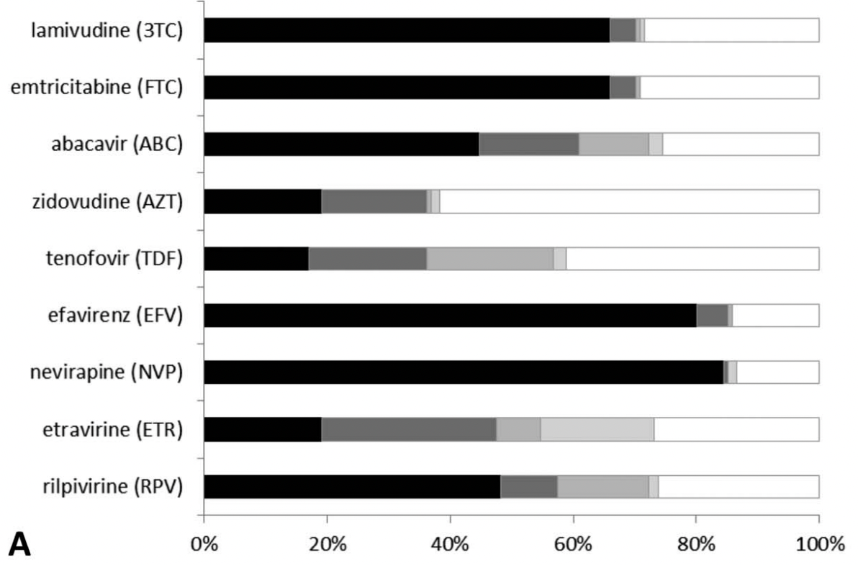
Similar data from Kenya and DRC
Cross–sectional study (N=305)
Hosp. patients w/ HIV admitted Kenya + DRC on efavirenz-based ART >6m
Half showed evidence of suboptimal adherence using dried blood spot drug levels
50% had VF w/ VL >1000 copies and drug resistance common
Bossard, et al. J Acquir Immune Defic Syndr 2021
Notes:
Early in the epidemic, inpatients largely were ARV naïve
But now most patients admitted to hospital in African settings with a complication of HIV are ART experienced.
In a study of inpatients in Kenya and the DRC, most patients who were admitted while on ART were failing and most of them had HIV DR.
Currently in most countries such patients cannot be identified or switched to second line ART rapidly and in most cases will be discharged on the same failing regimen.
It makes sense to begin to offer VL testing for inpatients consider 2nd line ART for this patient group if VL found to be elevated on admission.
Same will be true among patients presenting to clinic with OI; if on ART substantial group will be failing; get the viral load. If lapsed from ART, continue rapid init of TLD after OI treatment is tolerated.
86% had efavirenz resistance
>70% had dual-class resistance
Similar study in Malawi, 30% of patients receiving ART for >6 months who were admitted had VF.
More than 90% of that group had efavirenz resistance

Slide 44
Impact of DTG on advanced HIV?
Notes:
Since around 2016 South Africa and the region have embraced the Treat All strategy.
Treat All means offer ART to all HIV + patients irrespective of CD4 count. This increased ART coverage has already reduced the burden of advanced HIV.
We hope we will see a similar benefit from another big strategy change ; a shift to integrase inhibitor-based therapy.
integrase inhibitor based antiretroviral therapy anchored by the drug dolutegravir. DTG, as you may remember, along with Bictegravir are the preferred anchor agents for ART in the US and Europe so this is an impt shift.
Before we explain how this may help address the problem of advanced HIV, I first I wanted to briefly review timing of ART in advanced HIV
There have been some important changes in how ART is deployed in southern Africa.
The first has been the Treat All policy which expanded ART to all people with HIV regardliess of CD4 cell count.
The next was a major shift in the agents in first line treatment.

Slide 45
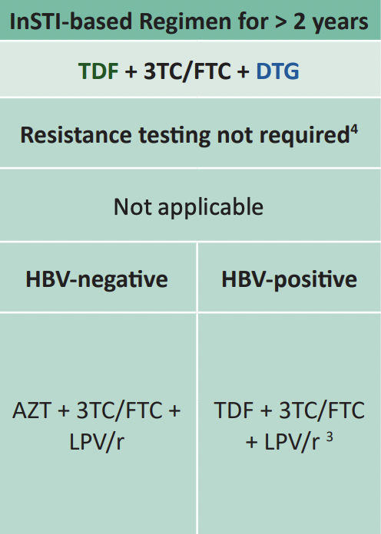
Potential Impact of TLD on advanced HIV
~80% of HIV (+) in SA receiving ART on DTG-based ART
TLD may reduce burden of advanced HIV and HIV-related deaths. Why?
Fewer on TLD may experience treatment failure overall
If virologic failure occurs, TLD can often be recycled
Better tolerated; fewer will discontinue TLD from AE
Uncertainties:
What is the prevalence of treatment failure in patients admitted to hospital with TLD ?
How to manage patients with VF -- particularly CD<200 -- while receiving TLD? Continue for 2 years before bPI switch?
SA 2019 ART Guidelines
Notes:
READ
One thing we are considering piloting for patients with neurologic OI, the use of injectable ART after acute phase.
DTG like certain boosted PIs has a very high barrier to resistance requiring multiple mutations before failure.
As shown in the Y axis it is also highly potent and rapidly reduces viral load.
Compared to other backbone antiretrovirals that are both highly potent and have high genetic barrier, it is better tolerated.
READ
The impact may be signficant in reducing prev of advanced HIV disease now that 75-80% receive DTG-based ART
Very potent so fewer people may experience treatment failure
Very well tolerated, better than EFV or boosted PI, so fewer may stop owing to Aes
The regimen is not prone to drug resistance, so if patients experience treatment failure most can resuppressive without switching
Few DDIs with other agents for OIs, except when given with Rifampinc for DS-TB, dose has to be incr to DTG 50 bd

Slide 46
Thank you
In memory of Dr. Iqbal Master

